Slide 1
ASSIGNMENT 3: ROBOTICS
Amitangshu Mukherjee
Archana Venkatachalapathy
Kai Liang Tan
Sin Yong Tan
Xian Yeow Lee

Slide 2
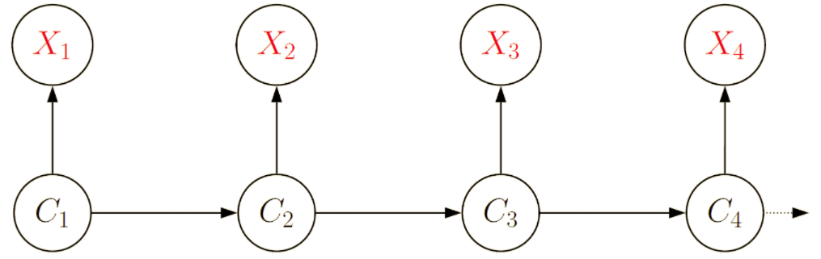
Problem Statement
To visualize and preprocess raw data of a robotic arm provided.
To train a Hidden Markov Model with nominal data and identify deviations in the anomalous data.
Parameters of Hidden Markov Model studied :
Number of Hidden States
Number of Observation Variables
Number of Iterations
Random Seed

Slide 3
Dataset
The given dataset is obtained from a robotic arm with 46 variables.
There are two condition in which data has been recorded : nominal and anomalous
There are 6 sets of controller variables (5 three-dimensional variables and 1 four dimensional variable) which gives 19 variables in total
The position, velocity and acceleration of the robot arm was recorded over 9 joints which gives 27 variables in total.

Slide 4
Approach
To infer the deviations of anomalous data from nominal data, the controllers data were taken as the Hidden Markov Model hidden states and the measurement data considered as the observed states
The Hidden Markov Model was trained with 3 sets of measurement data:
A subset of the full measurement data, consisting of 12 observable features
The full measurement data with 27 observable features
A concatenated matrix combining the the measurement and controller data with a total of 46 features

Slide 5
Approach : Preprocessing
Mean shift and normalization:
A mean shift and normalization was performed on the data for easier pattern comparison and variable selection (next step)
Variable selection:
Variable selection was performed by eliminating the variables that shows correlation with another variable, the variables that are constants, and variables with negligible changes
Visualization of selected datasets are shown in the following slides

Slide 6
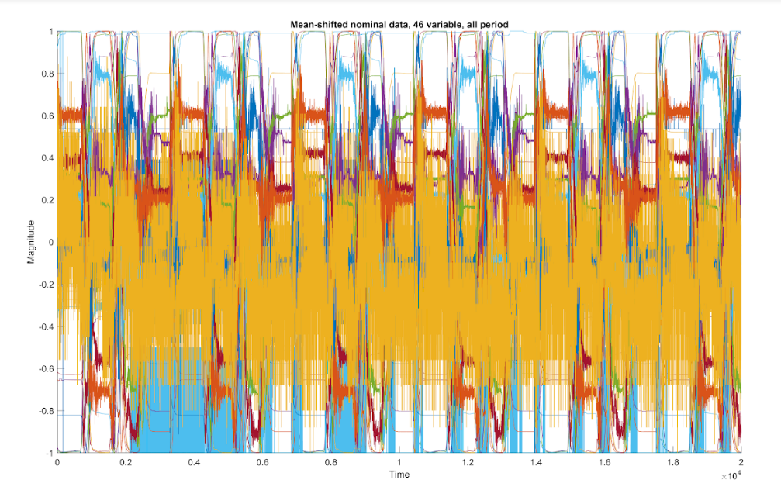
Figure 1. Normalized data with 20000 points and 46 variables

Slide 7
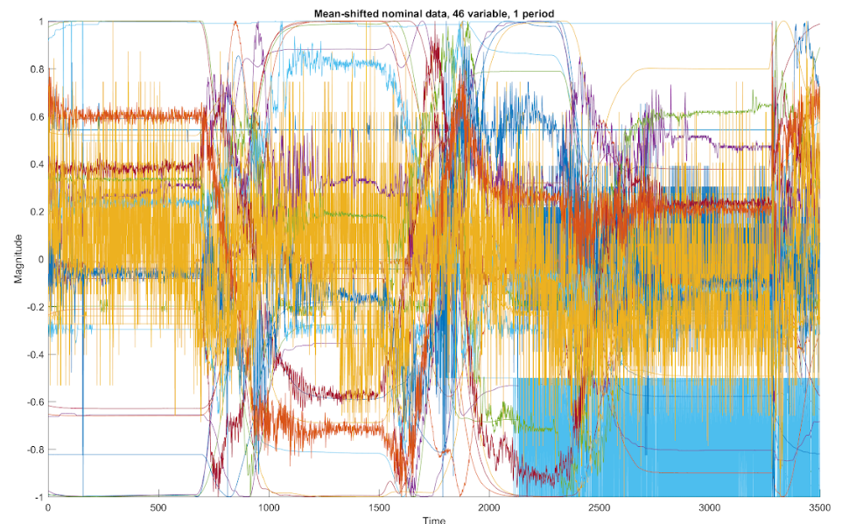
Figure 2. Normalized data from a single period with 46 variable

Slide 8
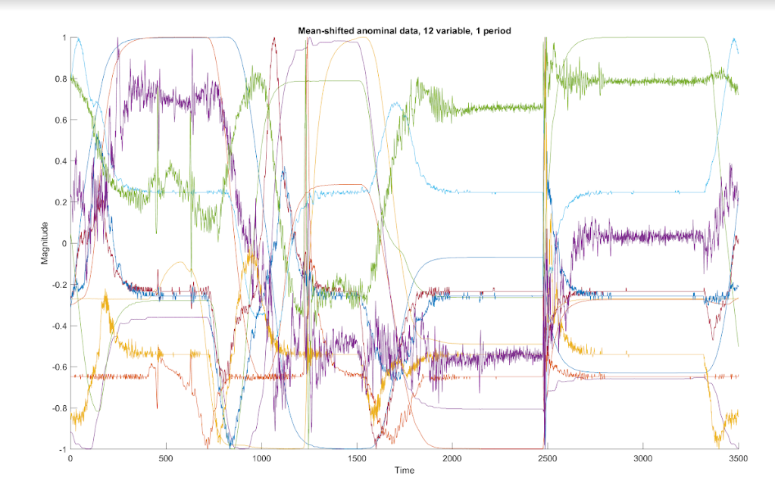
Figure 3. Normalized and preprocessed data from a single period with 12 selected variables

Slide 9
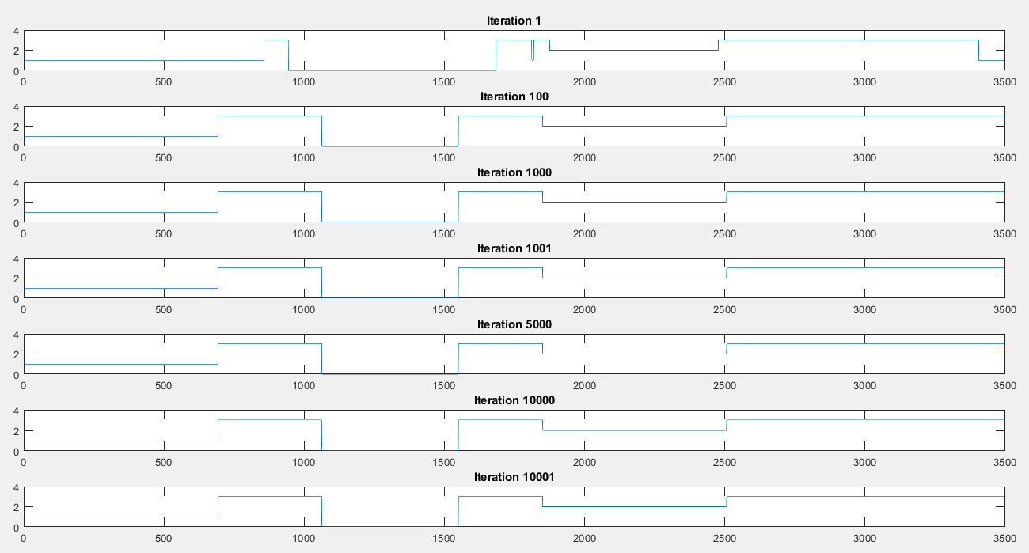
Figure 4. Comparison across multiple iterations

Slide 10
Approach : Training
From the previous graph, it can be observed that the hidden states predicted by the Hidden Markov Model converges after 10 iteration for an arbitrary number of input features and hidden states
Therefore, it was decided to keep the number of iteration to 10 for a clear comparison among different models
For consistency, we also fixed the random seed everytime we run the trainings

Slide 11
Approach : Training
Using the three different datasets mentioned, multiple Hidden Markov Models were trained with varying number of hidden states from 4 states to 3500 states
4 states was chosen as the minimum number of states because the data clearly falls into 4 discrete bands as can be seen in Figure 3
3500 states was chosen as the maximum number of states because that was number of data points the Hidden Markov Model is being trained with and this assumes that 1 data point represents a hidden state
After training, the Hidden Markov Model was used to predict the hidden state sequences of the nominal and anomalous data respectively

Slide 12
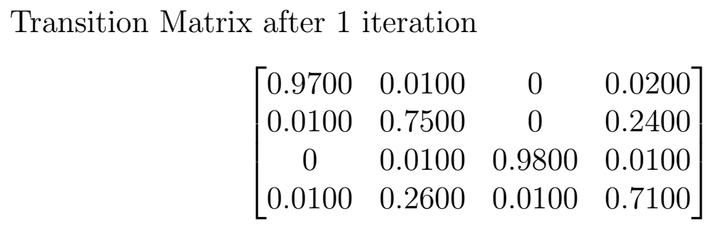
Design of Experiments
Table 1 summarizes the Hidden Markov Models trained with different parameters while keeping the number of iterations constant
The results of the predicted hidden states are shown in the subsequent slides
A sample of the state transition matrix obtained from training the Hidden Markov Model with 4 hidden states is also shown below:
Number of Nominal Input Variables | Number of Hidden States | Iterations
12 | 4 | 10
12 | 10 | 10
12 | 100 | 10
12 | 3500 | 10
27 | 4 | 10
27 | 10 | 10
27 | 100 | 10
27 | 3500 | 10
46 | 4 | 10
46 | 10 | 10
46 | 100 | 10
46 | 3500 | 10
Table 1. Design of Experiments

Slide 13
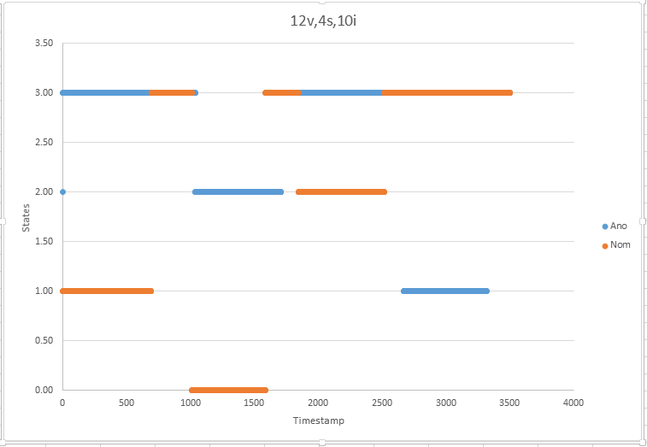
Results for 12 Input Features, 4 Hidden States and 10 Iterations

Slide 14
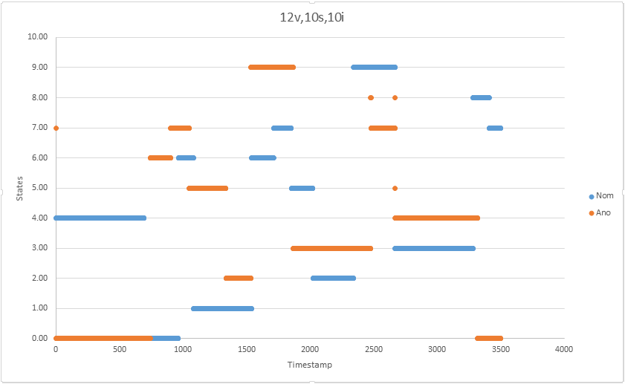
Results for 12 Input Features, 10 Hidden States and 10 Iterations

Slide 15
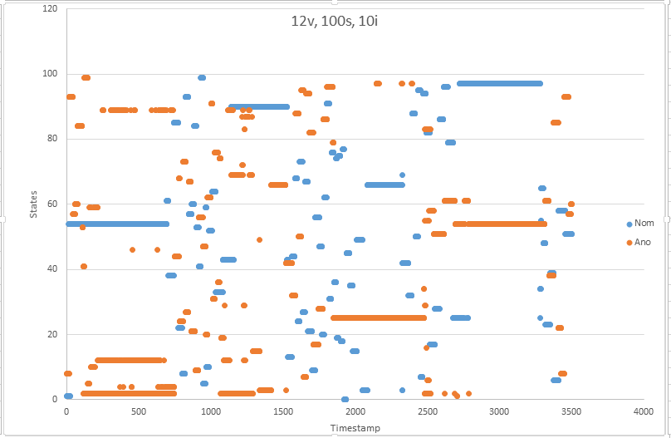
Results for 12 Input Features, 100 Hidden States and 10 Iterations

Slide 16
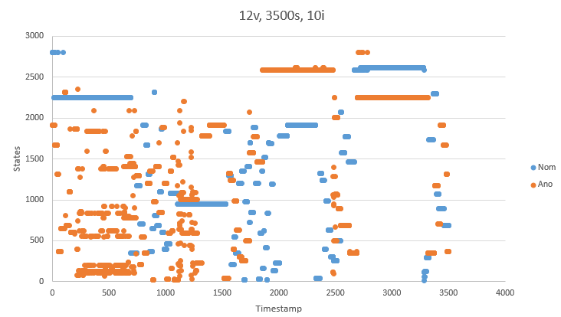
Results for 12 Input Features, 3500 Hidden States and 10 Iterations

Slide 17
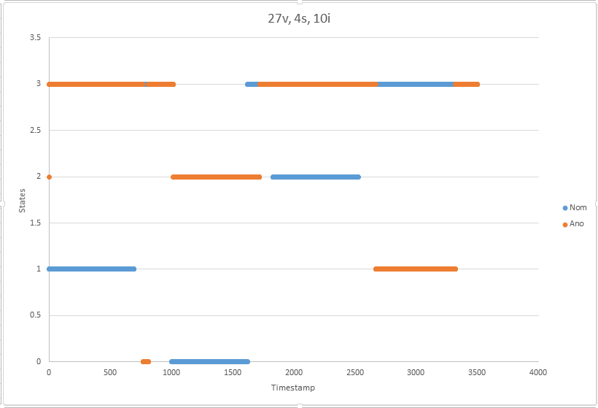
Results for 27 Input Features, 4 Hidden States and 10 Iterations

Slide 18
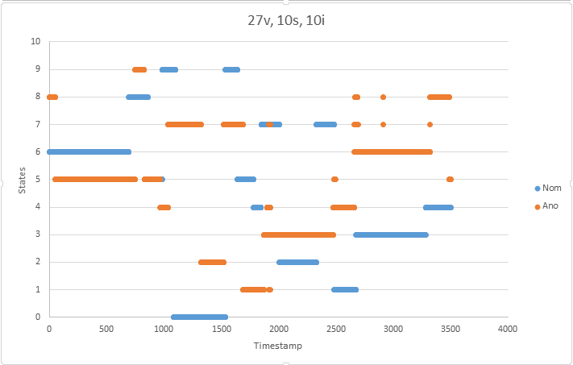
Results for 27 Input Features, 10 Hidden States and 10 Iterations

Slide 19
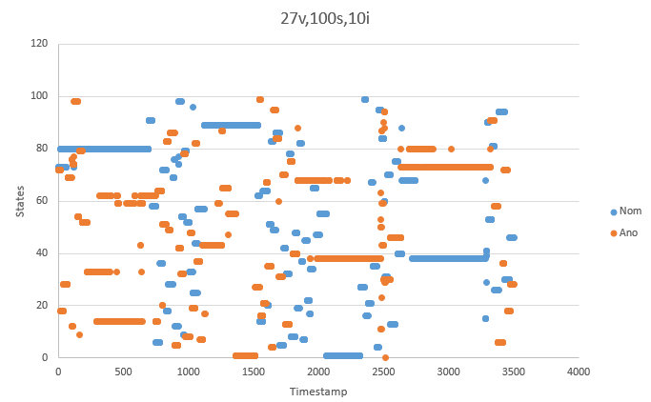
Results for 27 Input Features, 100 Hidden States and 10 Iterations

Slide 20
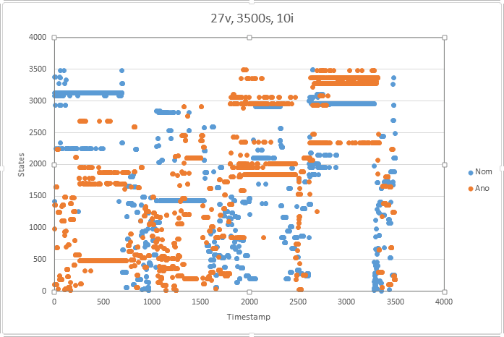
Results for 27 Input Features, 3500 Hidden States and 10 Iterations

Slide 21
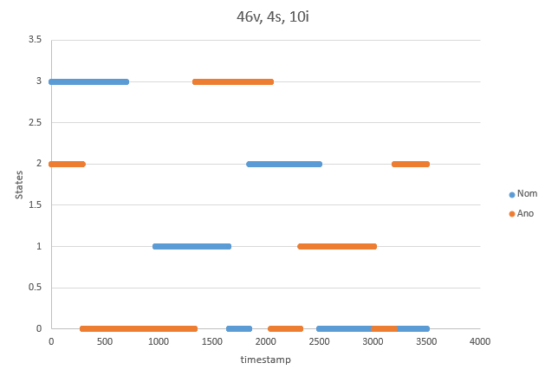
Results for 46 Input Features, 4 Hidden States and 10 Iterations

Slide 22
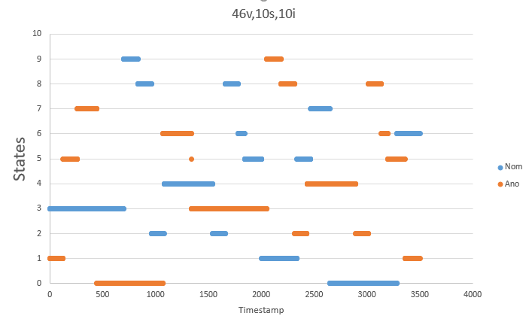
Results for 46 Input Features ,10 Hidden States and 10 Iterations

Slide 23
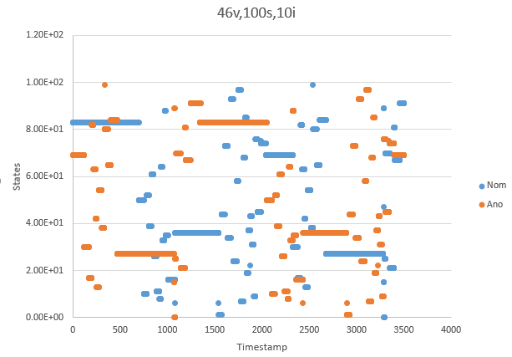
Results for 46 Input Features ,100 Hidden States and 10 Iterations

Slide 24
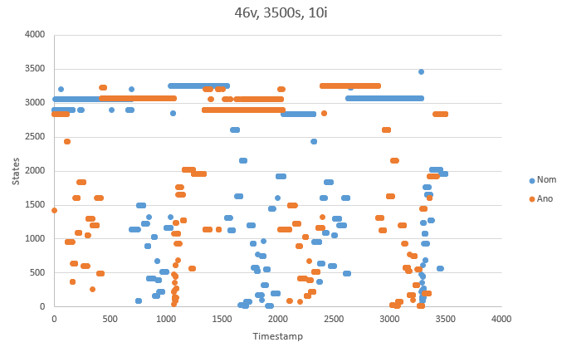
Results for 46 Input Features ,3500 Hidden States and 10 Iterations

Slide 25
Results
From the results shown above, it can clearly be seen that the Hidden Markov Model infers that the robotic arm goes through different sequences of hidden states given the nominal and anomalous data
It is also observed that for a given subset of input variables, the Hidden Markov Model with 4 hidden states best predicts the state sequences. At 3500 states, the model tries to predict the transition of the robotic arm from one state to another as a hidden state and that resulted in a very noisy state sequence

Slide 26
Results
Another important observation is the comparison of the Hidden Markov Models trained with a different number of input feature variables while keeping the number of output states constant. Models trained with different number of input features predicted a different hidden state sequence which suggest that the Hidden States predicted implies different variables.

Slide 27
Discussion
The drawback of the results presented above is that the hidden states in the Hidden Markov Model is represented only by one random variable and cannot be interpreted. Thus, it cannot be inferred exactly which feature in the 19 controller variable is causing the anomaly.
An alternative solution to this problem is to train 2 separate Hidden Markov Models with the nominal and anomalous data of 46 controller and measurement variables. The 19 controller variables can then be tweaked iteratively until the hidden states of the two Hidden Markov Model converges.

Slide 28
Discussion
However, this is not a robust solution as the observations are related to the hidden states through the emission matrix, which is a probability. Thus, it cannot be concluded that any particular combination of controller variable is deterministically causing the anomaly
A second alternative to solve this problem is to implement a Dynamic Bayesian Network where the hidden states are not represented by a single random variable

Slide 29
Challenges
No ground truth to compare predicted hidden states so accuracy of the model couldn’t be verified
Variable selection (which variable to choose)
Choosing suitable number of hidden states for the Hidden Markov Model
In short, a Hidden Markov Model is probably not a good model for anomaly detection as suggested in the discussion session.

Slide 30
Special traits or observations purely from the data
Joint 9 was practically not moving (zero position, velocity, acceleration throughout the periodicity)
Joint 1 and 8 have very small movements relative to other joints. (it could probably be the vibration due to some movements of other joints)
Joint 3, 6 and 7 have the same position and velocity changes graph patterns

